Slide 1
UHMC PROPOSED FY 2022 Operating Budget Presentation
October 22, 2021

Slide 2
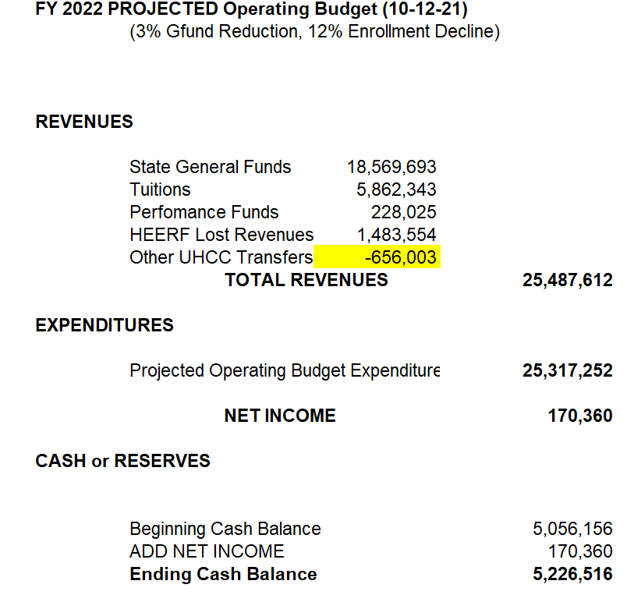
FY 2022 annual operating budget proposal

Slide 3
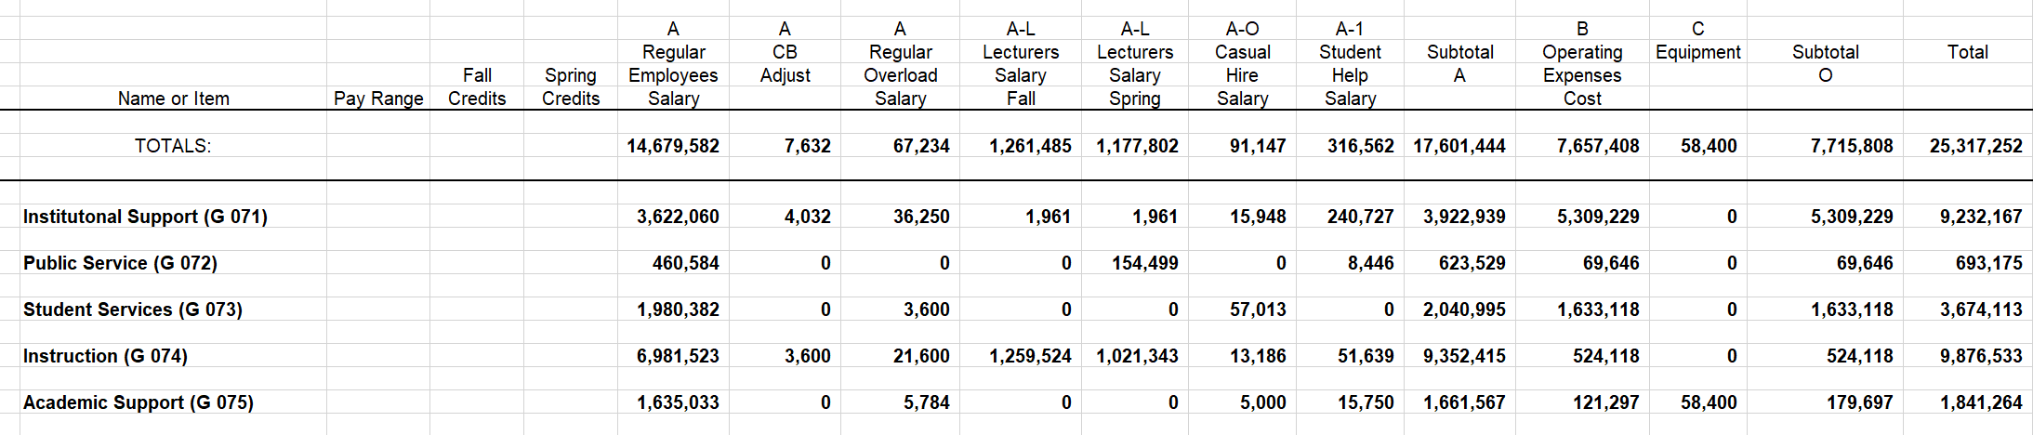
PROPOSED FY 2022 OPERATING BUDGET

Slide 4
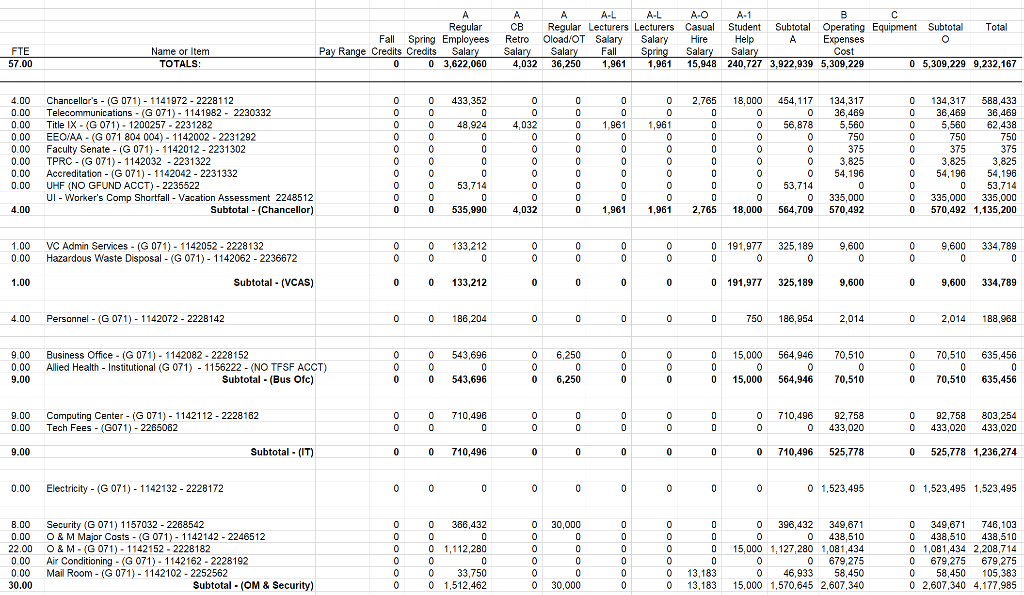
INSTITUTIONAL SUPPORT OPERATING BUDGET

Slide 5
Institutional Budget Highlights
Title IX Coordinator: filled
Janitor III $45K
Building Maintenance Worker $60K
Mailroom Clerk $50K
Chancellor’s Office: $100K to support marketing – funded with HEERF lost revenues.
Business Office: Procurement Specialist $60K
Computing Center: Faculty IT Coordinator $75K
Electricity: Projected increases for MFIC and more in-person presence, $200K.
Sewer, Water, Gas: Projected increases from MFIC and more in-person, $150K.
O&M: 2x Groundskeeper, 1x Maintenance Worker, Fire contract, Hood cleaning contract. $300K

Slide 6
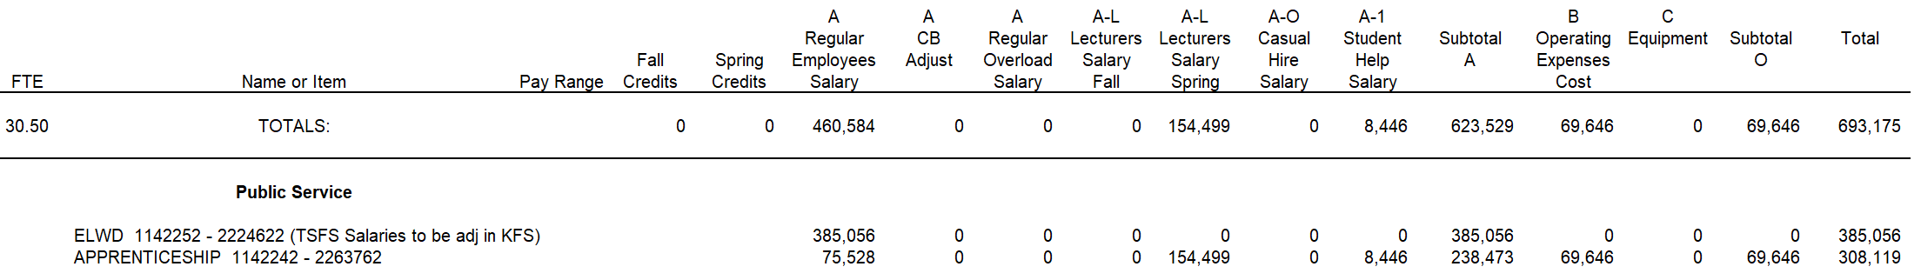
PUBLIC SERVICE (ELWD) OPERATING BUDGET

Slide 7
PUBLIC SERVICE Budget Highlights
Maui Food Innovation Center, APT salaries and fringes, HEERF Lost Revenues - $97,500
Maui Food Innovation Center – 2x Faculty Coordinators $150K
Apprenticeship Program - $100K lecturer budget

Slide 8
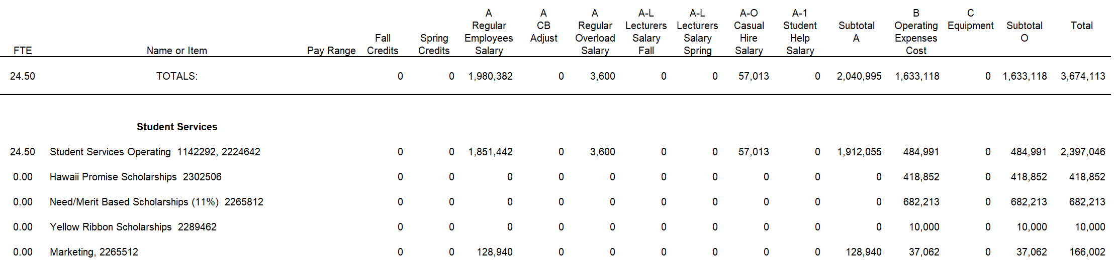
STUDENT AFFAIRS OPERATING BUDGET

Slide 9
STUDENT AFFAIRS Budget Highlights
Enrollment Mgt Spc salaries and fringes, HEERF lost revenues - $128K
Recruiter, salaries and fringes, HEERF lost revenues - $128K
Disabilities Counselor - $90K
Financial Aid Specialist
Admissions and Records Specialist
Sign Language Interpreter Contract - $395K

Slide 10
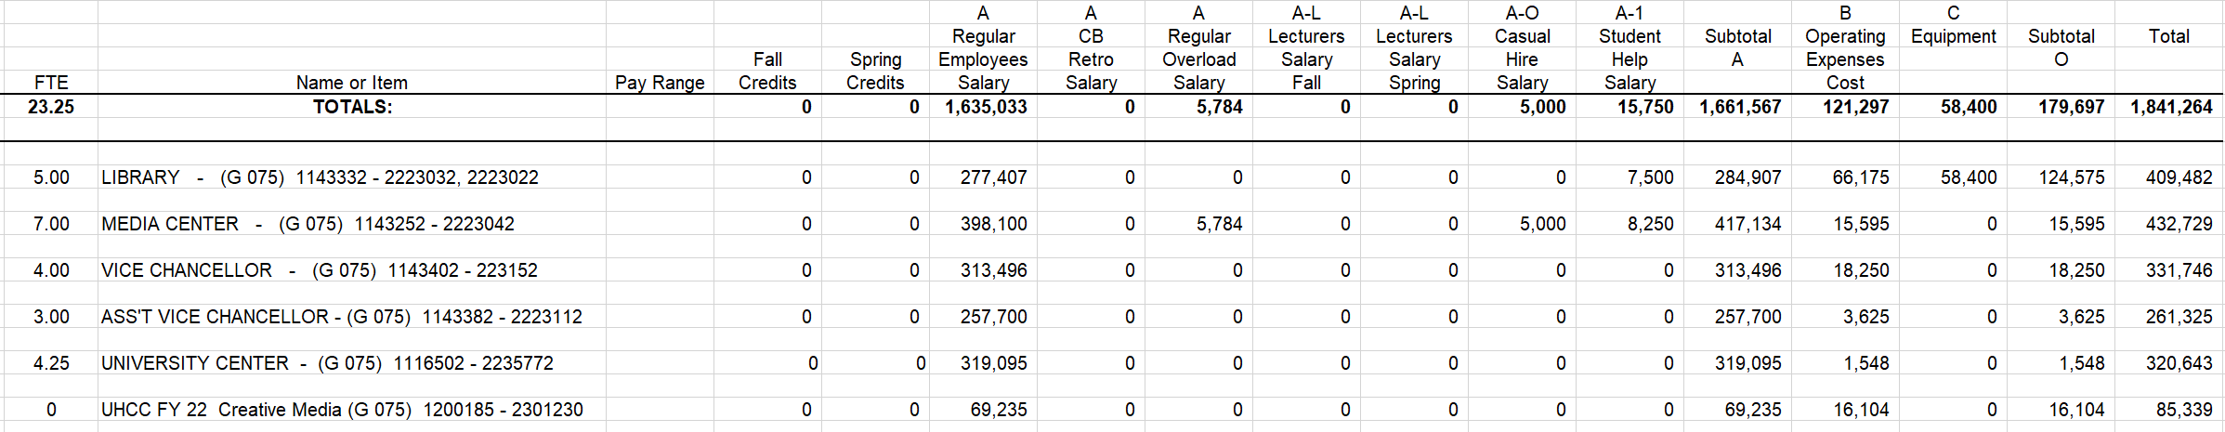
ACADEMIC SUPPORT OPERATING BUDGET

Slide 11
ACADEMIC SUPPORT Budget Highlights
Institutional Researcher - $75K
Vice Chancellor for Academic Affairs - interim - $110K
Library Technician - $60K

Slide 12
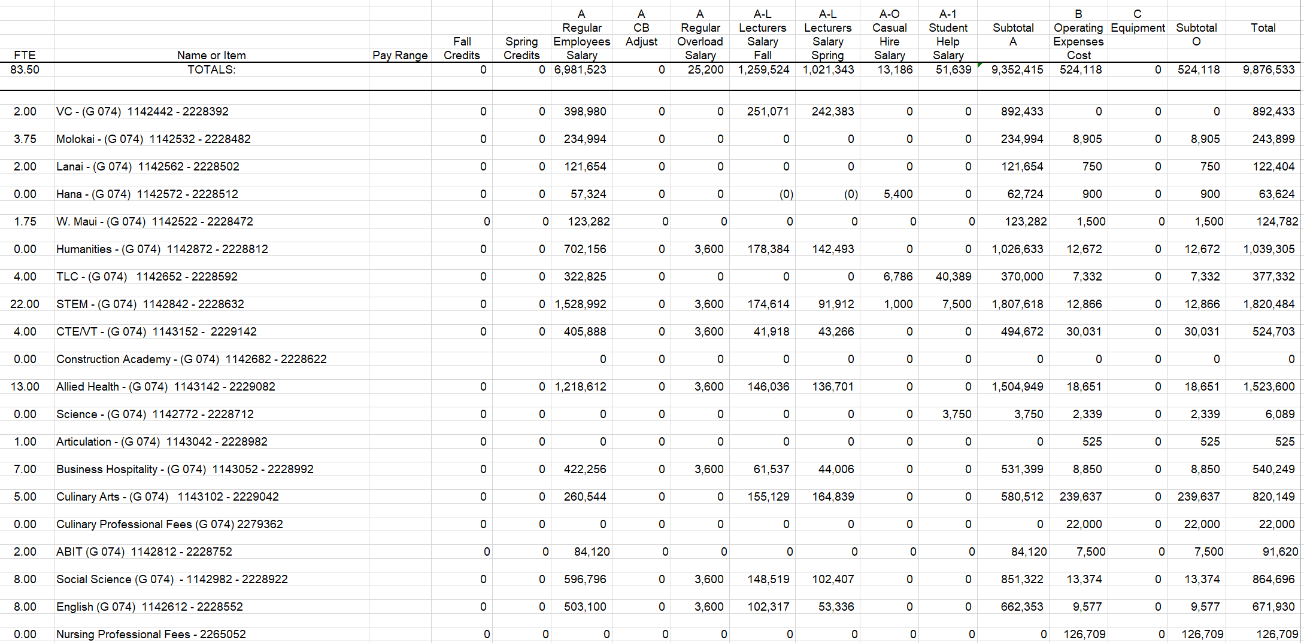
INSTRUCTION OPERATING BUDGET

Slide 13
instruction Budget Highlights
Molokai Academic Specialist – $60K
Salaries for 4.0 FTE Faculty, to be vetted and determined - $300K
Lecturer budget increase - $380K
Hawaiian Studies Faculty – $75K
Construction Tech Faculty - $75K
Allied Health Faculty - $90K

Slide 14
Budget SUMMARY
Continues stringent budgets for travel, student help, casual hires and operating funds.
Funds 6 general fund positions which were approved in April 2021
Funds 3 HEERF lost revenue positions which were approved in April 2021
Funds 17 additional general fund positions
Funds 2 Student Affairs positions that will become vacant for immediate refilling.
Net income of $170K
5 vacant general fund positions remaining.

Slide 15
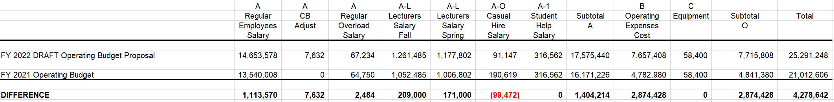
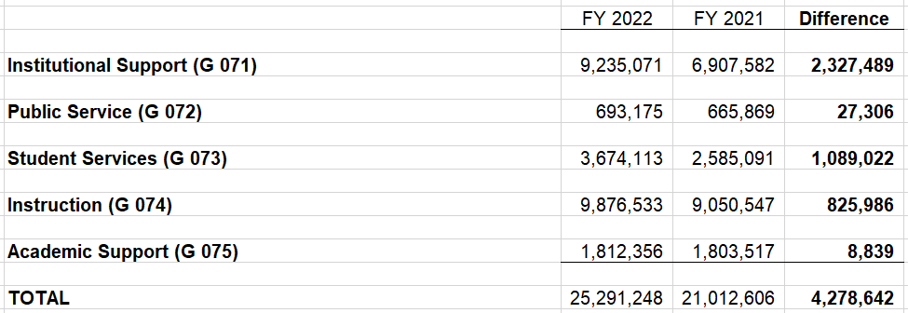
FY 2021 Budget vs fy 2022 Proposed

Slide 16
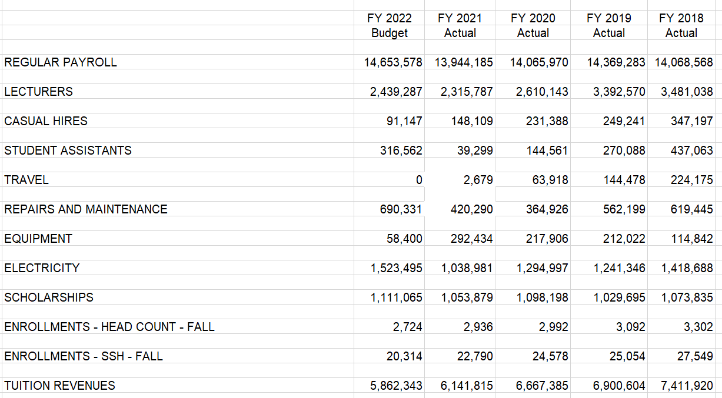
Major Costs Historical Trend

Slide 17
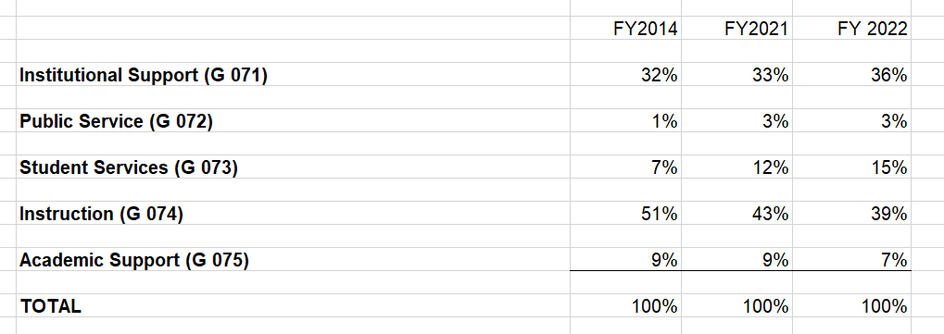
Percentage of Funding to major units

Slide 18
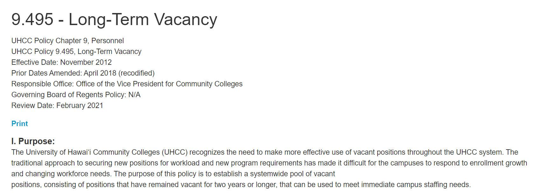
Management of vacant positions

Slide 19
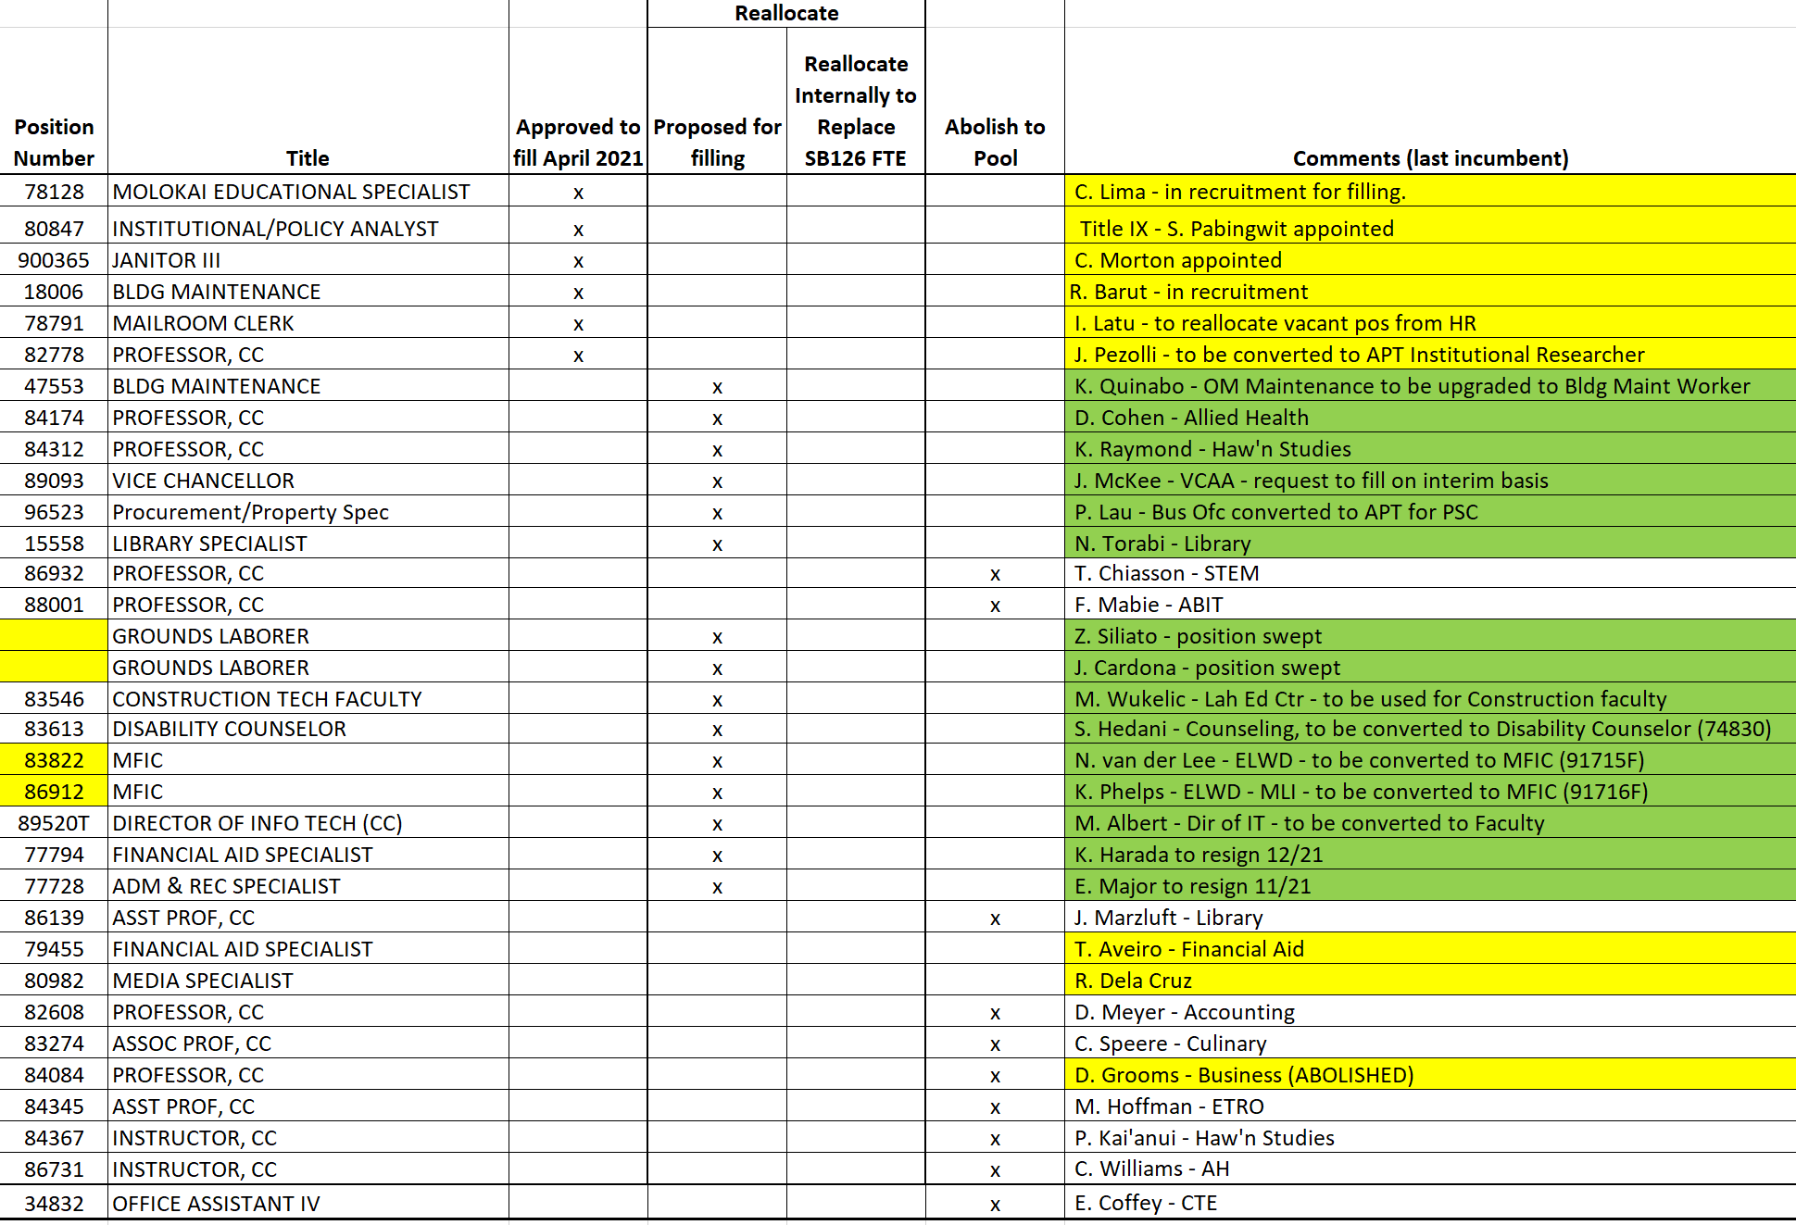
STAFFING PLAN

